Slide 1



Blue cross blue shield of Massachusetts
BLUE CROSS BLUE SHIELD OF MASSACHUSETTS
CONFIDENTIAL – NOT FOR DISTRIBUTION
Blue Cross Blue Shield of Massachusetts is an Independent Licensee of the Blue Cross and Blue Shield Association.
Notes:
Good afternoon, today I will be going over the new HMO and PPO Plans offered to you by Hampshire County Insurance Group effective 7/1/26.

Slide 2
agenda
Medical plans
Network Blue New England Deductible - New
Blue Care Elect Deductible - New
Notes:
Beginning July 1, 2026, Hampshire County Group Insurance Trust is changing from Non Deductible HMO and PPO Plans to the Network Blue NE HMO Deductible Plan and the Blue Care Elect PPO Deductible plan.
Dependents are covered through the end of their 26th birthday month.
There are no waiting periods and no pre-existing condition limitations.

Slide 3
MEDICAL PLANS COMPARISON
Network Comparison
Network Blue NE Deductible HMO | Blue care Elect Deductible PPO
Regional HMO Blue NE network in MA, ME, NH, VT, CT and RI | National PPO network Blue Cross Blue Shield PPO providers
Choose Primary Care Physician (PCP) (change anytime!) Referrals to most HMO Blue NE network specialists NO referrals to HMO Blue NE network: Ob/gyn care & Behavioral Health & Routine Vision Chiropractors & Acupuncturists Emergencies & Out-of-Area Urgent Care | In-network PPO Providers: richer benefits Out-of-network Providers: reduced benefits NO referrals required Go to any licensed provider nationwide Freedom of choice Use in-network or out-of-Network providers
Find a doctor: ONLINE www.bluecrossma.org Call Physician Selection Service: 1-800-821-1388 | Find a doctor: ONLINE www.bluecrossma.org Call Physician Selection Service: 1-800-821-1388
Notes:
This slide goes over the major differences between an HMO and PPO.
As it is today with your current HMO Plan, the Network Blue NE Deductible plan uses the HMO Blue New England list of medical providers that participate in blue cross blue shield HMO plans in all 6 New England States. There is NO coverage for Out of Network Providers under the HMO Plan.
HMO Blue new england members must choose and list a Primary Care Physician, or PCP
And if you are enrolled in the HMO Plan, you MUST obtain Referrals to specialists. Please note the services on this slide that you do NOT need a referral for: These include: OB/GYN care, mental health visits, routine vision, chiropractors and acupuncturists and Emergency Room and Out of Area Urgent Care.
The blue care elect preferred deductible PPO plan uses the list of participating blue cross blue shield PPO providers nationally.
PPO members are not required to choose a Primary Care Physician and are not required to get referrals to see specialists.
PPO members may choose where to receive care. Medical providers who participate in BCBS’s PPO are considered to be In-Network and members will pay less for care at In-Network providers. Providers who are not in the PPO network are considered to be Out-of-Network and members will pay more for care at Out-of-Network providers.
Both the HMO and PPO cover you worldwide for Emergencies and out of area Urgent Care.

Slide 4
Common financial terms
$
Copayment
Deductible
Coinsurance
Out-of-Pocket Maximum
Allowed Amount
Notes:
Your blue cross blue shield health plan is here to help you off set the cost of your medical care. Here are some of the most common financial terms associated with your medical care using your health plan:
A Co-payment is a flat dollar amount that plan members must pay the provider at the time of service. Also called a copay, this amount varies depending on the specifics of a given health plan contract.
A Deductible is a one-time dollar amount that a member must pay for health care services before the health plan will cover eligible services.
A Coinsurance is a percentage amount of eligible expenses that plan members are responsible for paying, most often after the deductible is met
An Out-of-Pocket Maximum is the most out-of-pocket costs a plan member will pay per year for covered health expenses before the plan pays 100 percent of covered health expenses for the rest of that year (typically includes, deductible, coinsurance and most copayments).
And lastly, the term Allowed Amount: The allowed amount is the maximum contracted fee that Blue Cross Blue Shield will reimburse a provider for a given service. This is the amount applied to the deductible and is the basis of the coinsurance percentage.

Slide 5
Understand your deductible
www.bluecrossma.org
Deductible
A DEDUCTIBLE is a fixed amount you pay for certain medical services before Blue Cross begins to pay
YOU’LL PAY THE FULL COST OF DEDUCTIBLE SERVICES like labs, x-rays, and hospital stays until you meet your deductible
EXAMPLE
If your deductible is $250, you will pay the first $250 of health care expenses that are subject to the deductible before the health plan will cover medical expenses
ARE ALL MEDICAL EXPENSES SUBJECT TO THE DEDUCTIBLE?
No. Refer to your plan documents for more detailed information
Notes:
To help you understand your new deductible plans, I will first start with helping you understand your deductible. Certain medical services are subject to a deductible under the new plans. As mentioned on the previous slide a deductible is a fixed amount you must pay before your health plan begins to pay your bills.
Under Hampshire county’s new deductible plans, the deductible will be $250 per member and $500 per family. For example if you go to the Dr and they require that you have blood work and an MRI for a complaint or issue that you are having, You will pay the first $250 of these health care expenses as an individual before the new health plan will cover these medical services.
Are All Medical Expenses Subject To The Deductible? No. Some services on your plan will only apply a Copay and the Deductible will not apply. The future Slides will go over this in more detail.

Slide 6
Medical Plans Comparison
In-Network Medical Services
 |  | Network Blue NE HMO | Blue Care Elect PPO
 | MEDICAL SERVICES | MEMBER COST SHARING
 | Deductible | $250 individual $500 family | $250 individual $500 family
DOCTOR OFFICE VISITS | Routine health checkups & related tests | $0 | $0
 | PCP, OB/GYN, Behavioral Health visits | $20 | $20 after deductible
 | Virtual PCP Visit | $20 | $20 after deductible
 | Specialist office visits | $60 | $60 after deductible
 | Physical, Speech Therapy, Cardiac Rehab | $20 | $20 after deductible
EMERGENCY AND URGENT CARE | Emergency Room visits | $100 | $100 after deductible
 | Urgent Care facilities | $60 | $60 after deductible
EQUIPMENT | Prosthetics, Durable Medical Equipment | 20% after deductible | 20% after deductible
DIAGNOSTIC TESTING | Labs & X-Rays | $0 after deductible | $0 after deductible
 | MRI’s, PET & CT Scans | $100 after deductible | $100 after deductible
HOSPITAL | Hospital Day Surgery | $250 after deductible | $250 after deductible
 | Inpatient Admissions | $500 after deductible | $500 after deductible
Notes:
As you will see on this slide, for some benefits under both plans, you have to meet the deductible before the plan pays. The deductible is $250 for each member each plan year but will not be more than $500 for a family.
On both plans, in-network routine health checkups are covered in full including related preventive tests. Routine health checkups include annual routine physicals for adults and children, annual preventive gynecological exams and routine vision exams year.
On the Network blue plan, doctor office visits, emergency room visits and urgent care visits are covered with just a copayment.
For prosthetics, durable medical equipment, diagnostic testing, hospital day surgeries and inpatient hospital stays, are subject to the deductible and then you pay a copayment or are covered in full.
On the blue care elect plan, all medical services are subject to the deductible then a copayment.
The copayment for diagnostic office visits to a primary care physician, ob/gyn or for behavioral health visits is $20 on the network blue and $20, after the deductible on the blue care elect.
A diagnostic office visit is when you visit a doctor to treat, diagnose or monitor a medical complaint or condition.
There is a $60 copayment for visits to in network specialists on the network blue and you pay a $60 copay after the deductible on the blue care elect plan.
You will be responsible for a $20 copay on the network blue and $20 copay, after the deductible, on the blue care elect for in network physical therapy, speech therapy and cardiac rehabilitation.
Emergency room visits are covered after a $100 copayment on both plans, but after the deductible on the blue care elect plan. This copayment is waived if you are admitted.
You may save money by visiting an independent free-standing Urgent Care Facility and pay a lower dollar amount, equivalent to what you would pay for in network specialist office visits.
On both plans you will pay 20% coinsurance after the deductible for Durable Medical Equipment and Prosthetic Devices.
On both plans, for in-network labs and x-rays, you are covered in full, after the deductible. For high end imaging, such as MRIs, PET and CT scans, you will have a $100 copayment, after the deductible.
After you meet the deductible, you will pay a $250 copayment for hospital day surgeries and a $500 copayment for inpatient hospital stays.

Slide 7
Medical Plans Comparison
Out-of-Network Medical Services
 |  | Network Blue NE HMO | Blue Care elect PPO
 | MEDICAL SERVICES | MEMBER COST SHARING
 | Deductible |  | $250 individual $500 family
DOCTOR OFFICE VISITS | Routine health checkups & related tests | N/A | 20% after deductible
 | PCP, OB/GYN, Behavioral Health visits | N/A | 20% after deductible
 | Specialist office visits | N/A | 20% after deductible
 | Physical, Speech Therapy, Cardiac Rehab | N/A | 20% after deductible
EMERGENCY AND URGENT CARE | Emergency Room visits | $100 | $100 after deductible
 | Urgent Care facilities | $60 outside service area | 20% after deductible
EQUIPMENT | Prosthetics, Durable Medical Equipment | N/A | 40% after deductible
DIAGNOSTIC TESTING | Diagnostic Testing (Labs & X-Rays, MRI’s, PET & CT Scans) | N/A | 20% after deductible
HOSPITAL | Hospital Day Surgery | N/A | 20% after deductible
 | Inpatient Admissions | N/A | 20% after deductible
The amount the BCE plan pays for covered services is based on the BCBSMA allowed amount. If an out-of-network provider charges more than the BCBSMA allowed amount, you may have to pay the difference
Notes:
For out of network services, the Network Blue plan covers you worldwide for Emergency Room visits. And Urgent Care Visits when out of the Service Area. There is no other Out of Network Coverage under the HMO plan.
On the Blue care elect, for out-of-network services, the deductible is the same as in-network. Once your plan year deductible has been met you are responsible for 20% coinsurance for most out-of-network services
The Emergency Room copayment is the same as in-network.
For out-of-network Prosthetics and Durable Medical Equipment, you pay 40% co-insurance after your deductible.
Please note that the amount the blue care elect plan pays for covered services is based on our allowed charges. If an out of network provider costs more that our allowed amount, you may have to pay the difference

Slide 8
Medical plans Comparison
Out-of-Pocket Maximum
 | Out-of-pocket maximum The most a member will pay per year for covered health expenses before the plan pays 100 percent of covered health expenses for the rest of that plan year
 | Network Blue NE HMO | Blue Care Elect PPO
MEDICAL SERVICES deductible coinsurance copayments | $5,000 Individual | $5,000 Individual
 | $10,000 Family | $10,000 Family
Notes:
As with the plans you are enrolled in today, You are protected by an Out-of-Pocket Maximum.
For Medical Services on both plans, the most you will pay each plan year for copayments, deductible and coinsurance is $5,000 for one member, or $10,000 for the entire family.

Slide 9
NEW!! Out of Area Dependent Coverage
Effective July 1, 2026 coverage is available for dependents living outside of the New England service area under the Network Blue New England Deductible Plan.
In addition to out-of-area emergency and urgent care, which is available to all members, this benefit allows for dependents living outside the New England service area to receive in-network coverage for non-emergency medical and mental health care when they register with us.
Get Started Today!
Call Team Blue at 1-800-486-1136.
Notes:
New as of July 1, 2026 Members that are enrolled in the Network Blue NE Deductible plan and have dependents that maybe are enrolled in College outside of New England or maybe live with a Parent out of the New England area can enroll in the HMO Plan and have coverage for those dependents. These dependents must be registered as an Out of Area Dependent. You can register them by calling in to Member Services. The Subscriber, their spouse or the dependent if over 18 are eligible to call and register their dependent.
When registered for Out of Area Dependent Coverage, certain services that aren’t usually covered when administered
outside the New England service area will now be covered, including:
• Preventive care services
• Outpatient medical care office visits
• Mental health care
• Follow-up care, when required, after leaving the emergency room or after an inpatient hospital stay
Please note: Some services may require authorization from your health care provider. And you must still make sure you are seeing Providers that are In Network with their Local BCBS as an HMO Provider.
9

Slide 10
Open Enrollment Decision Support
Need help with your open enrollment decision?
Call 1-800-486-1136 and press prompt 3 to speak to a benefit specialist and learn more about what plan may be right for you.
Benefit specialists are available from 8AM – 6PM EST.
Notes:
We have set up an Open Enrollment Support Decision Line for Hampshire County members to call in to during pre-enrollment, This feature allows you to speak with a Member Service representative and have a one on one discussion about your plan options. You can call M-F 8:00am to 6:00pm EST at 1-800-486-1136, Choose Option # 3. Identify themselves as a Member of Hampshire County Group Insurance Trust.
10

Slide 11

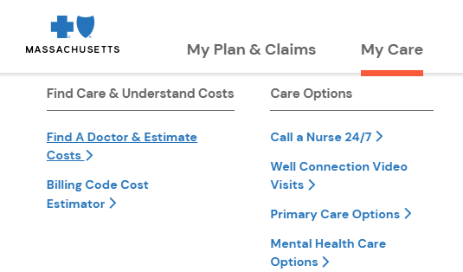

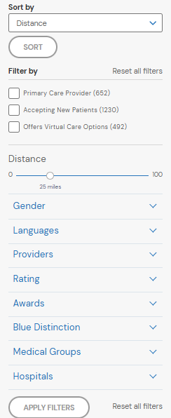
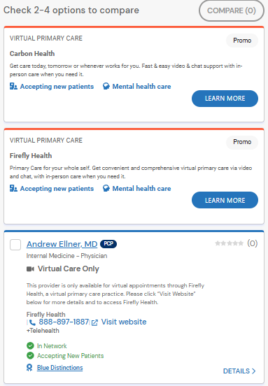

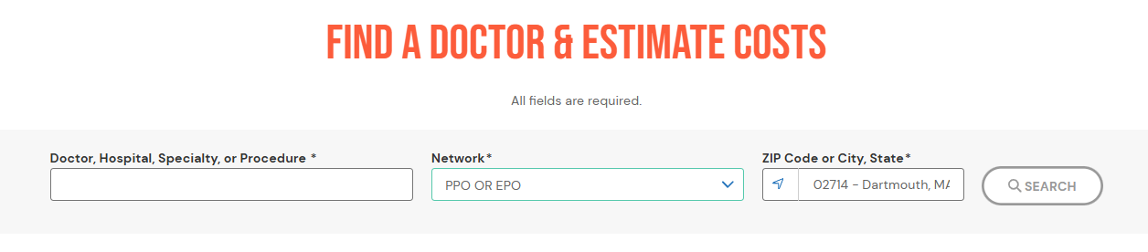
Find a doctor
www.bluecrossma.org/myblue
Notes:
To find a doctor, Hospital or procedure, first - log into your my blue account. Click on My Care then click on Find a doctor & Estimate Costs. A new screen with Find a doctor and Estimate Costs pops up. Since you logged into your MyBlue account your network and zip code will be auto populated for you. Type in the doctor’s name or if you are looking for a specialty – such as finding a primary care doctor, type in Primary care. A new screen will appear that will list the doctors in your network. You can narrow down your search by using the sorting filters. You can also check off 2 to 4 options and click the compare icon to see side by side comparisons.

Slide 12




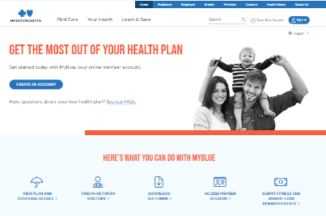









MYBLUE app & ONLINE ACCOUNT
Unlock the power of your plan
www.bluecrossma.org
FIND A DOCTOR
MENTAL HEALTH RESOURCE CENTER
VIEW ID CARD
Notes:
Your plan has more benefits than you probably realize.
The online MyBlue account and mobile app gives you an instant snapshot of your plan, including:
Coverage & Benefits, Claims, Find a Doctor, Cost Estimates, and more.
Plus, view a copy of your ID card and ID card for your dependents who are under the age of 18!
Go to bluecross m a.org or download the my blue app to sign up for My blue.

Slide 13

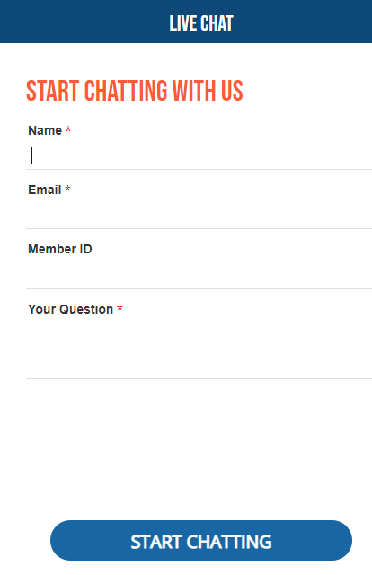




We are here to help
www.bluecrossma.org
Call Member Advocate 1-800-262-2583
Talk to a Nurse 1-888-247-2583
Video Doctor Visits www.bluecrossma.org/myblue
Send a Secure Message www.bluecrossma.org/myblue
Notes:
We are here to help.
If you need provider information or wish to speak with a Blue Cross Blue Shield member advocate about your membership, benefits or claims, please call between 8 a.m. and 6 p.m. Or visit bluecross m a.org and chat with us using the chat feature
Medical advice from a registered nurse is available 24 hours a day at no charge by calling our Blue Care Line toll-free number.
For video doctor visits and mental health therapy visits, log-in to your MyBlue account to use the Well-Connection benefit, using your smartphone, tablet or computer.
You may visit our web site anytime and even email a member advocate by using an online secure inquiry form after you log in to your MyBlue account.
Thank you, for taking the time to log in to this event to learn about your benefits.

